Slide 1
Mapping Apparent Porosity of Surficial Rocks Discovered By the Mars Exploration Rovers
By: Shane DePinto (NAU, Geophysics)
Mentored by: Chris Okubo (USGS, Astrogeology)

Slide 2
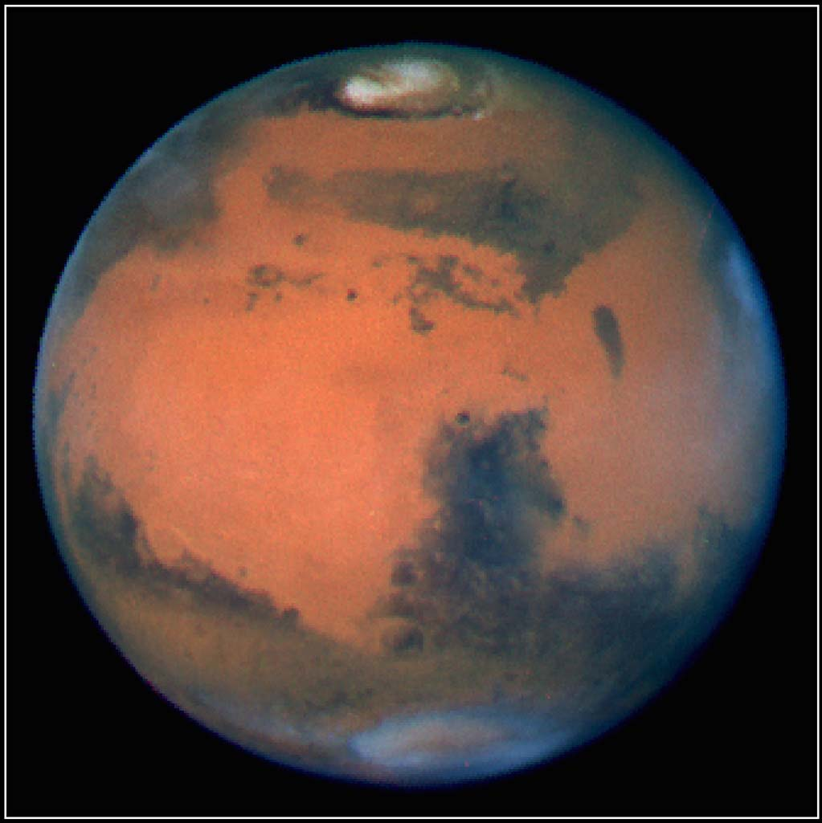
The Big Picture
Research on Mars helps us to understand the geologic history and past habitability of the planet
Understanding porosity of rocks on Mars provides insight into potential hydrologic conditions in the past and the mechanical strength of these crust materials

Slide 3
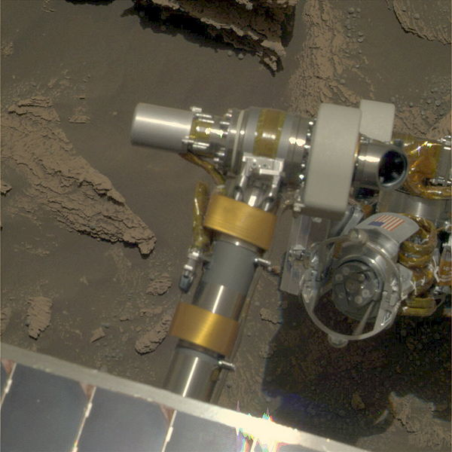
How We did it…
During the early part of its mission, the Mars Explorer Rover Opportunity (MERB) ground and brushed in situ rock samples (45mm x 5mm) to remove weathering effects and loose sediment
Its Microscopic Imager (MI) was used to take series of photos of each sample
I compiled a database of MI data over the sample sites using the MER Analyst Notebook (a public database) and prepared/analyzed them

Slide 4
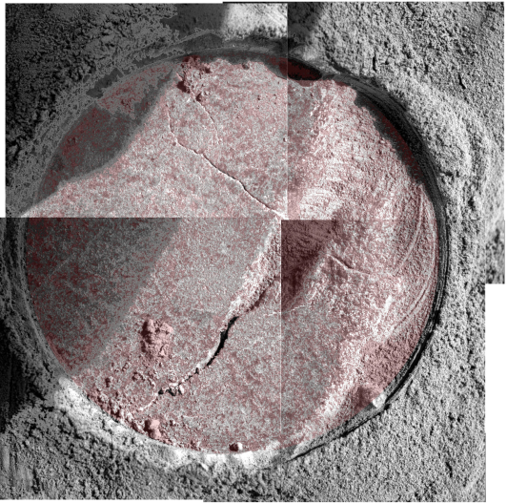
My Data
Mosaicked photos from each site together
Overlaid transparent layers on top and then deleted all apparent pore space from surface
Compared pixel data from unaltered overlay layer and altered overlay to calculate apparent visible porosity for each sample

Slide 5
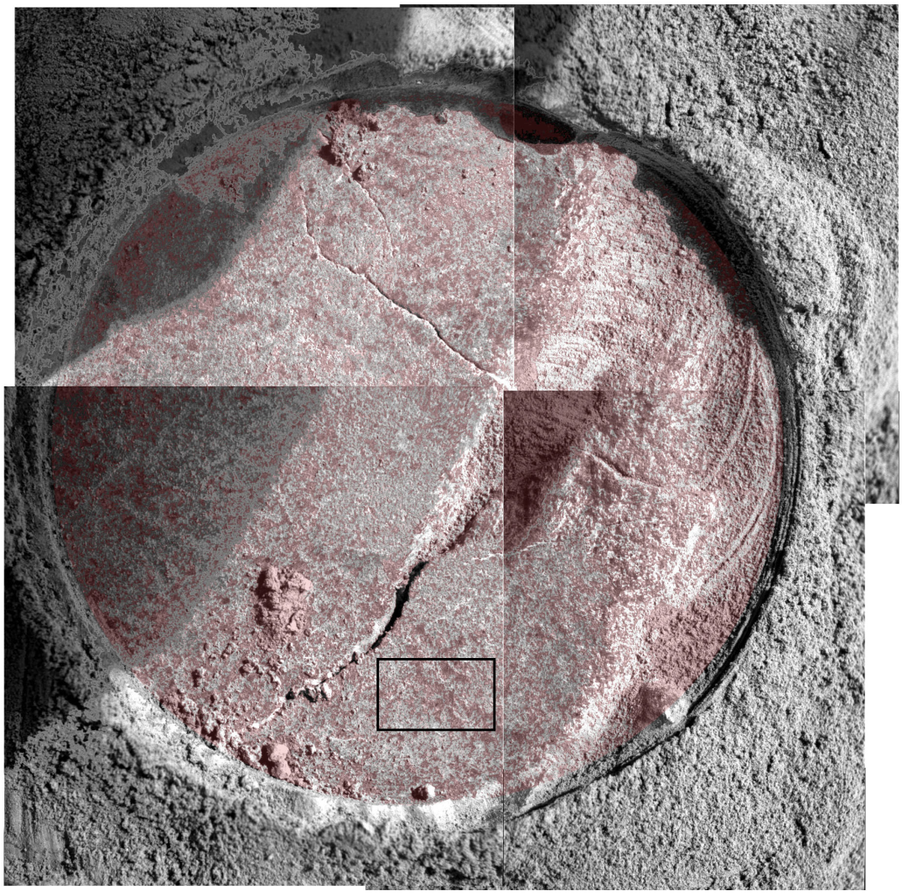
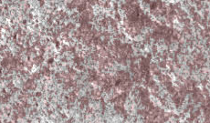
Example: Sol 1182
300x magnification

Slide 6
Analysis
I analyzed a total of 7 samples
The samples had apparent porosities ranging from 20.4%-59.61%
The porosity values are a bit high compared to Earth sedimentary porosity values, which are typically less than 20%
Porosities as high as 50% are not unheard of, especially in evaporite-rich sediments
The Mars rocks I analyzed are evaporite-rich sandstone
Turns out Martian rocks are similar to Earth’s

Slide 7
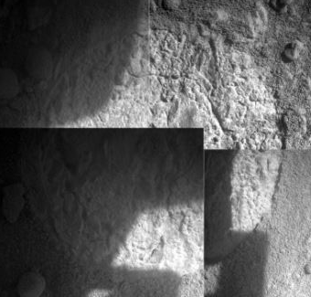
Problems that I found
They stopped doing it!
Sometime between sol 1316-1373…
Lighting is variable between photos and that makes analysis difficult
Porosity is a 3-dimensional aspect and analyzing it from a 2-D perspective is not extremely accurate

Slide 8
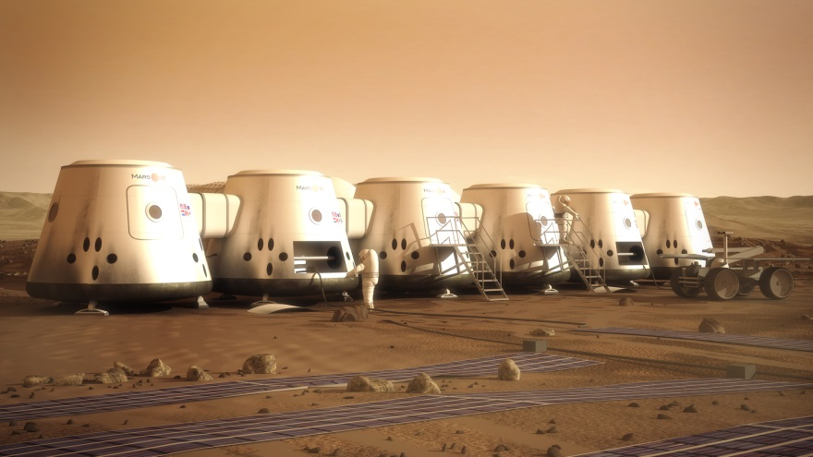
Conclusions
It appears as if Martian sedimentary rocks have a similar structure to Earth’s sedimentary rocks
This means cool things! Engineering aspects possibly, and verification of some of our geologic principles

Slide 9
Acknowledgements
Thanks to my Mentor Chris Okubo! You were extremely helpful in every stage of this project and helped me with all questions
Thank you NASA
Thanks NAU
Thank you Space Grant Symposium
Questions?

